Slide 1
AWS Lambda
Compute service

Slide 2
1. Need for AWS Lambda/ Motivation
suppose, we are building applications or websites and want to deliver great experience to users such as showing thumbnails when user uploads a picture or validating address when someone types address or loading videos on background while scrolling social media apps,
for these, our application needs some backend task or code that runs and responds to these events.
Managing the infrastructure to host and execute backend code can become difficult sometimes. so we need some service that manages the infrastructure for us and we can focus on code and business logic only.
Here comes AWS Lambda in Picture

Slide 3
2. What exactly is AWS Lambda?
AWS Lambda is serverless compute service
AWS Lambda executes our code only when needed and scales automatically.
With Lambda, you can run code for virtually any type of application or backend service - all with zero administration.
Just upload your code and Lambda takes care of everything required to run and scale your code with high availability.
You can set up your code to automatically trigger from other AWS services or call it directly from any web or mobile app.

Slide 4
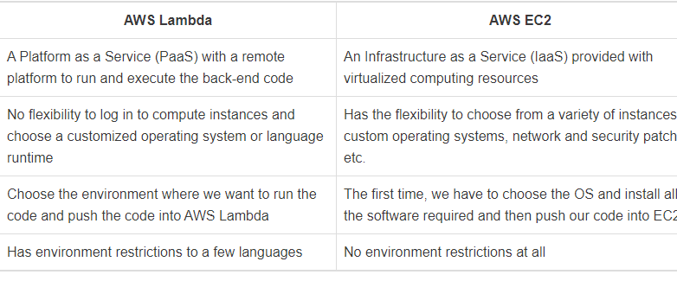
3. AWS Lambda vs AWS EC2

Slide 5
4. Benefits of AWS Lambda
No servers to manage
Continuous Scaling
Pay as you go
Easily monitor code performance in real time through CloudWatch

Slide 6
5. Limitations of AWS Lambda
Completely depended on AWS for the infrastructure
The maximum disk space provided is 512MB for runtime environment
The amount of memory available for lambda during execution is b/w 128 to 3008
The maximum amount a lambda function can be executed is 15 minutes.
Not all languages are supported in the lambda editor.

Slide 7
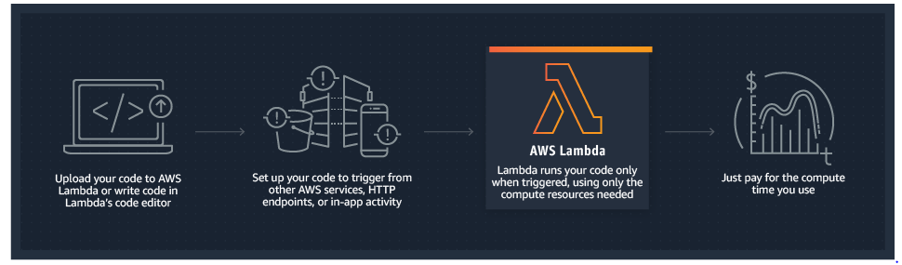
5. How it works

Slide 8
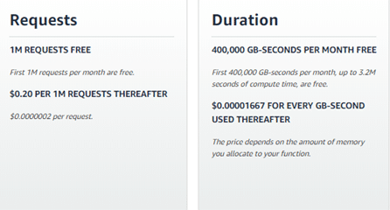
6. Pricing Model

Slide 9
Example: If you allocated 128MB of memory to your function, executed it 30 million times in one month, and it ran for 200ms each time, your charges would be calculated as follows:
Monthly compute charges
The monthly compute price is $0.00001667 per GB-s and the free tier provides 400,000 GB-s.
Total compute (seconds) = 30M * (0.2sec) = 6,000,000 seconds
Total compute (GB-s) = 6,000,000 * 128MB/1024 = 750,000 GB-s
Total Compute – Free tier compute = Monthly billable compute seconds
750,000 GB-s – 400,000 free tier GB-s = 350,000 GB-s
Monthly compute charges = 350,000 * $0.00001667 = $5.83

Slide 10
Monthly request charges
The monthly request price is $0.20 per 1 million requests and the free tier provides 1M requests per month.
Total requests – Free tier request = Monthly billable requests
30M requests – 1M free tier requests = 29M Monthly billable requests
Monthly request charges = 29M * $0.2/M = $5.80
Total compute charges
Total charges = Compute charges + Request charges = $5.83 + $5.80 = $11.63 per month

Slide 11
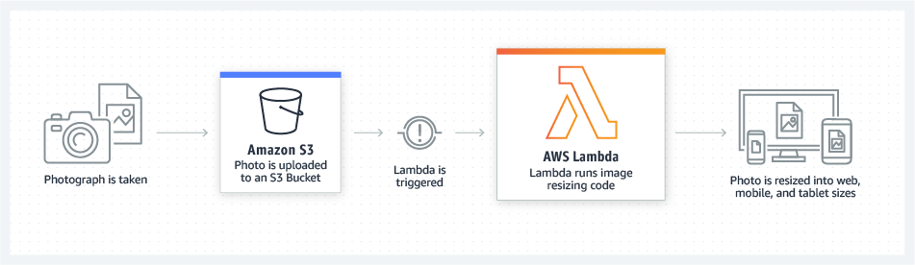
7. Real time use Cases
Real-time file Processing
ETL Jobs

Slide 12
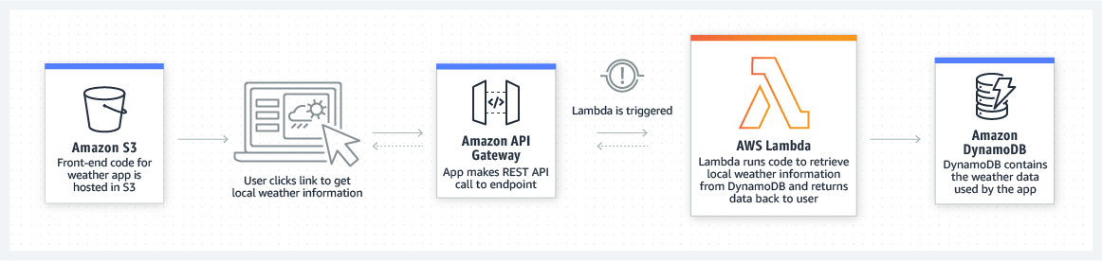
Web applications
Mobile Backends

Slide 13
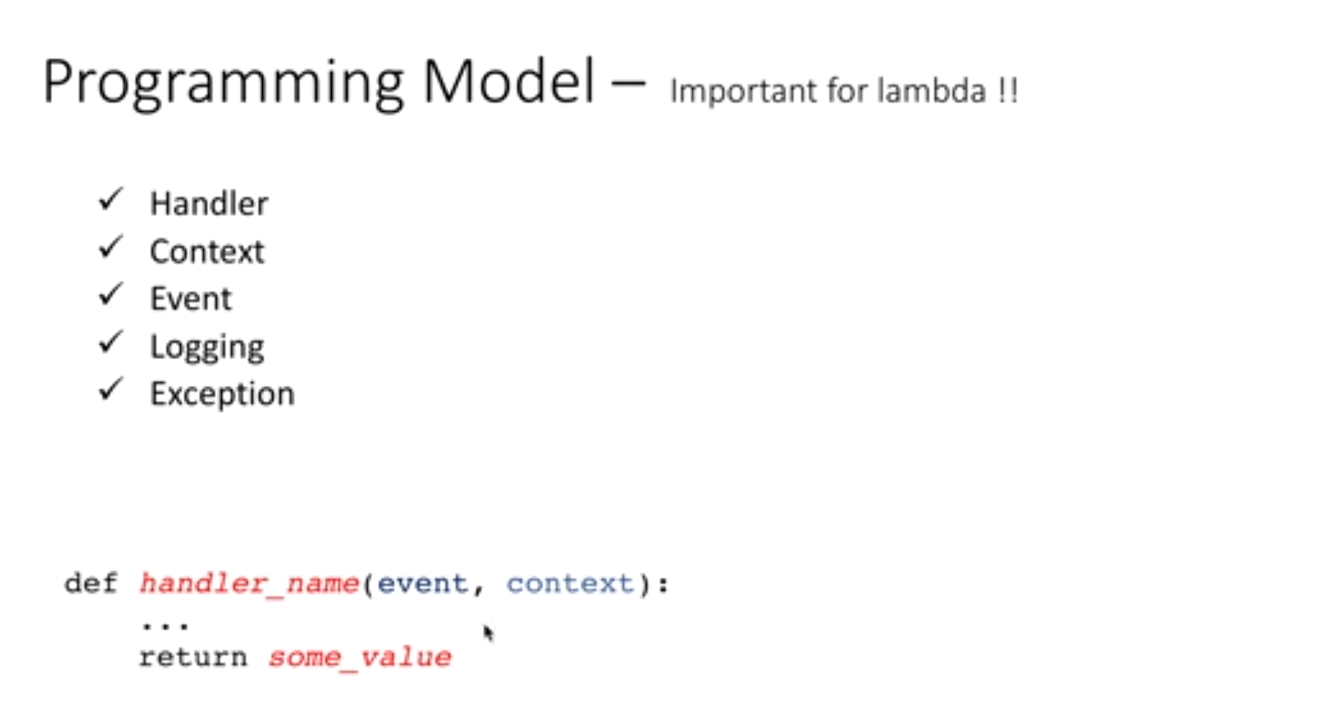
13.

Slide 14
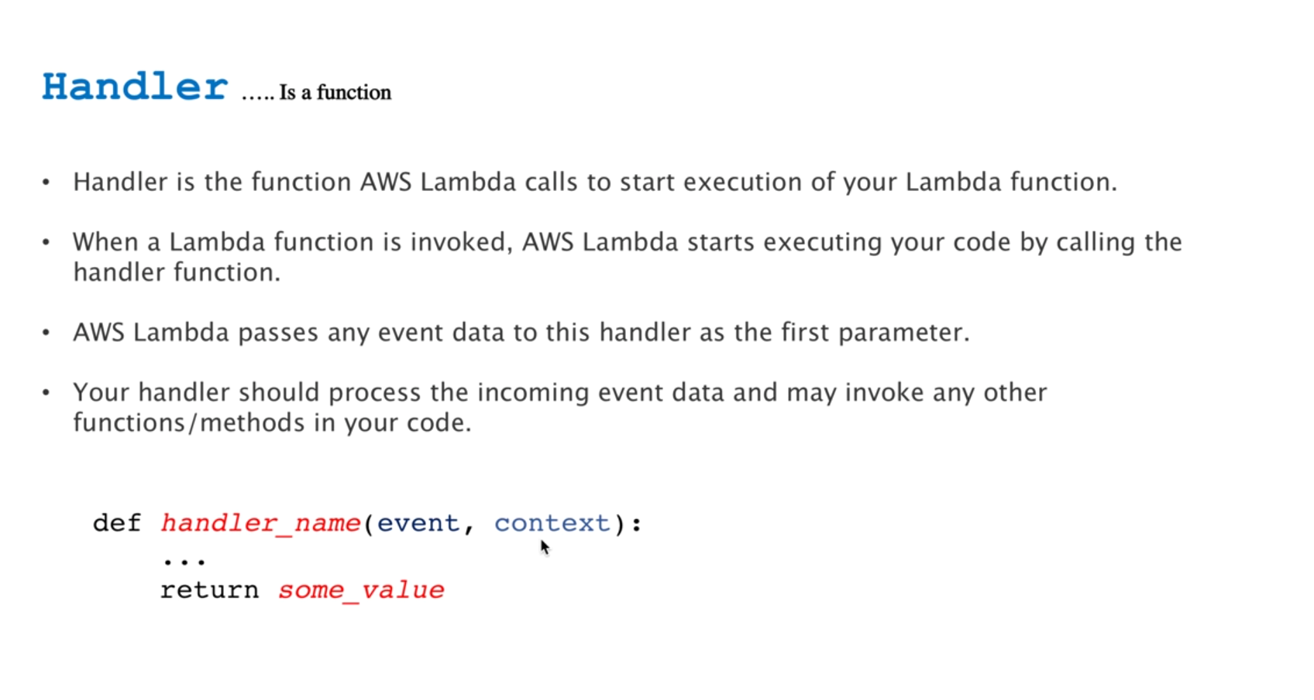

Slide 15
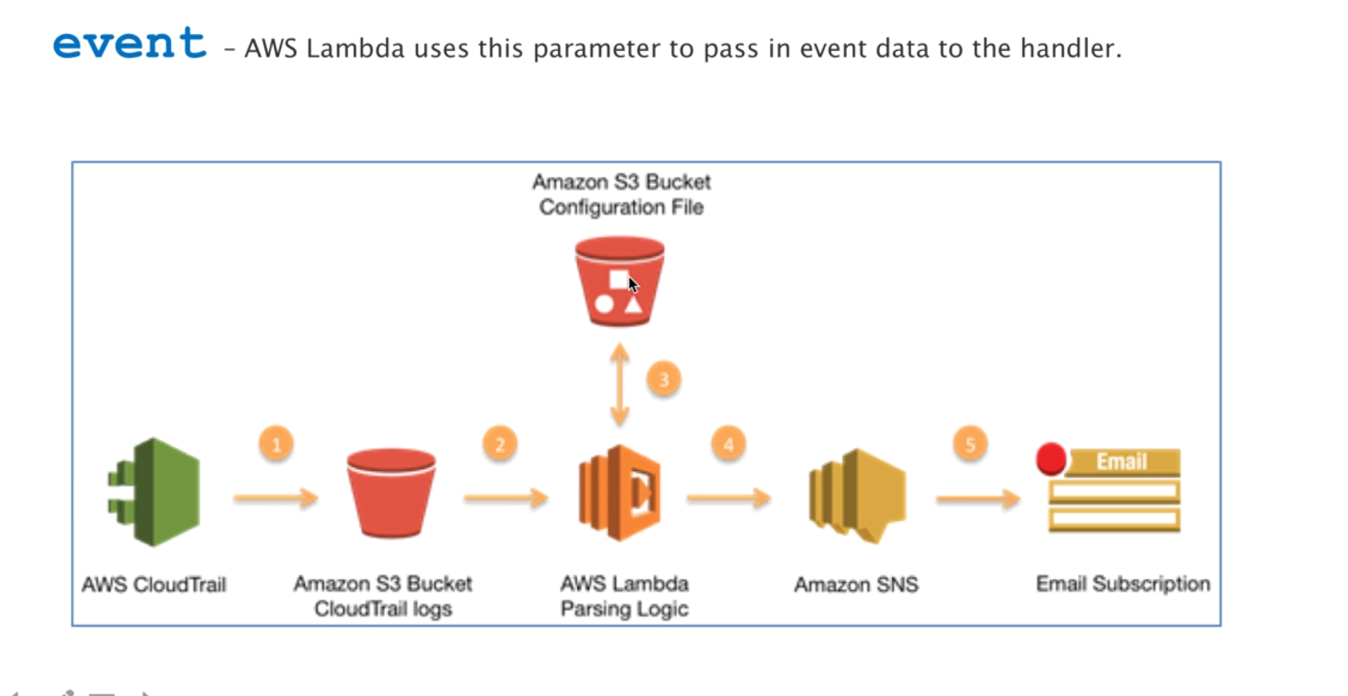

Slide 16
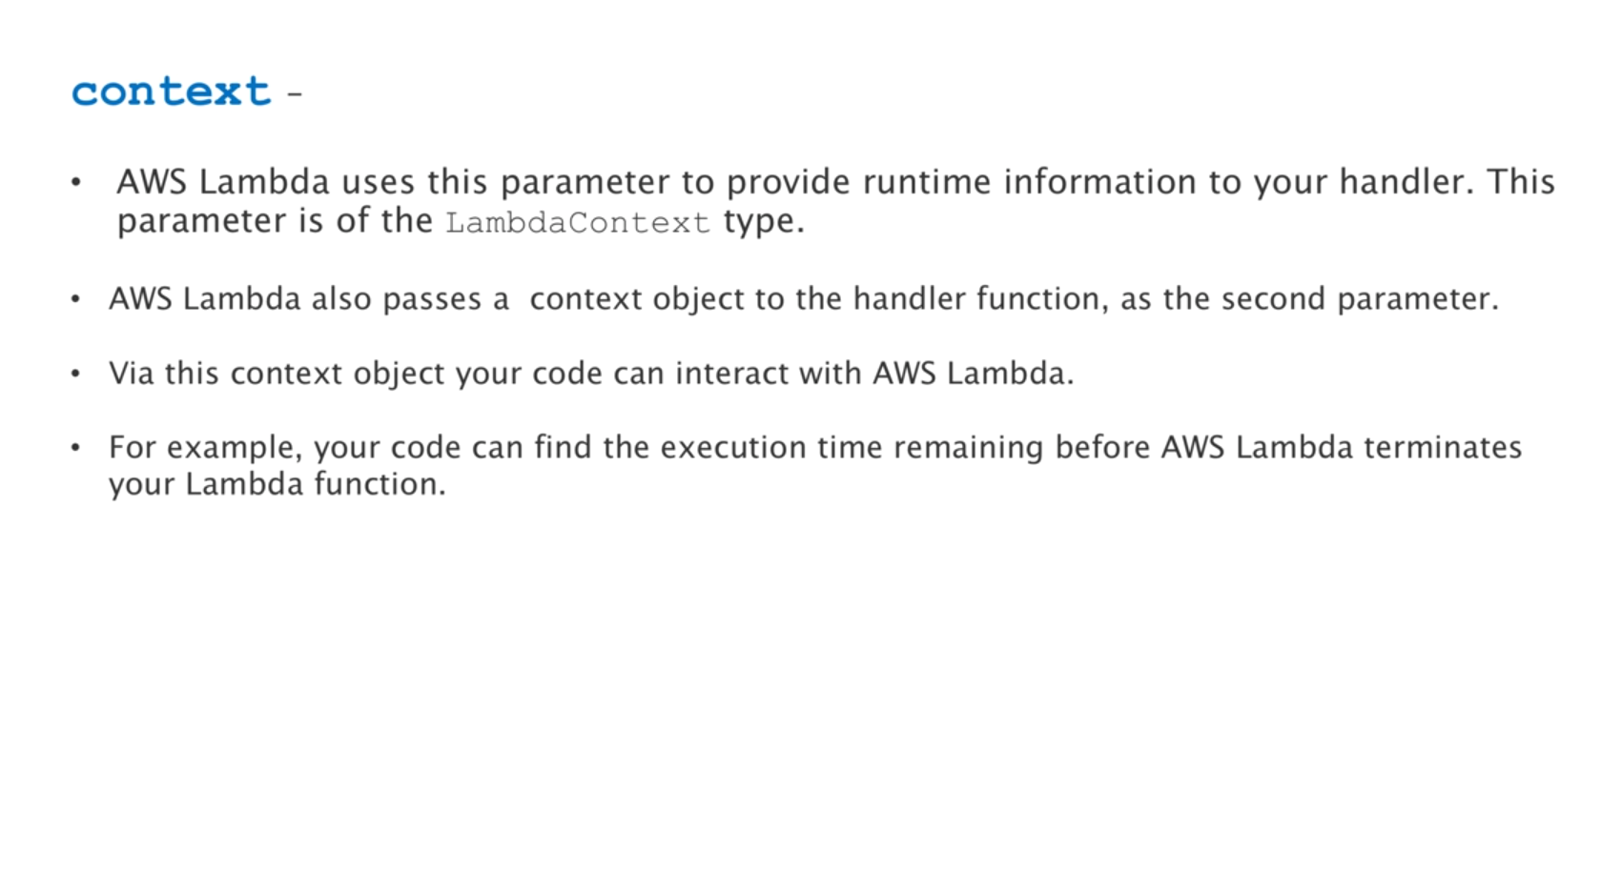

Slide 17
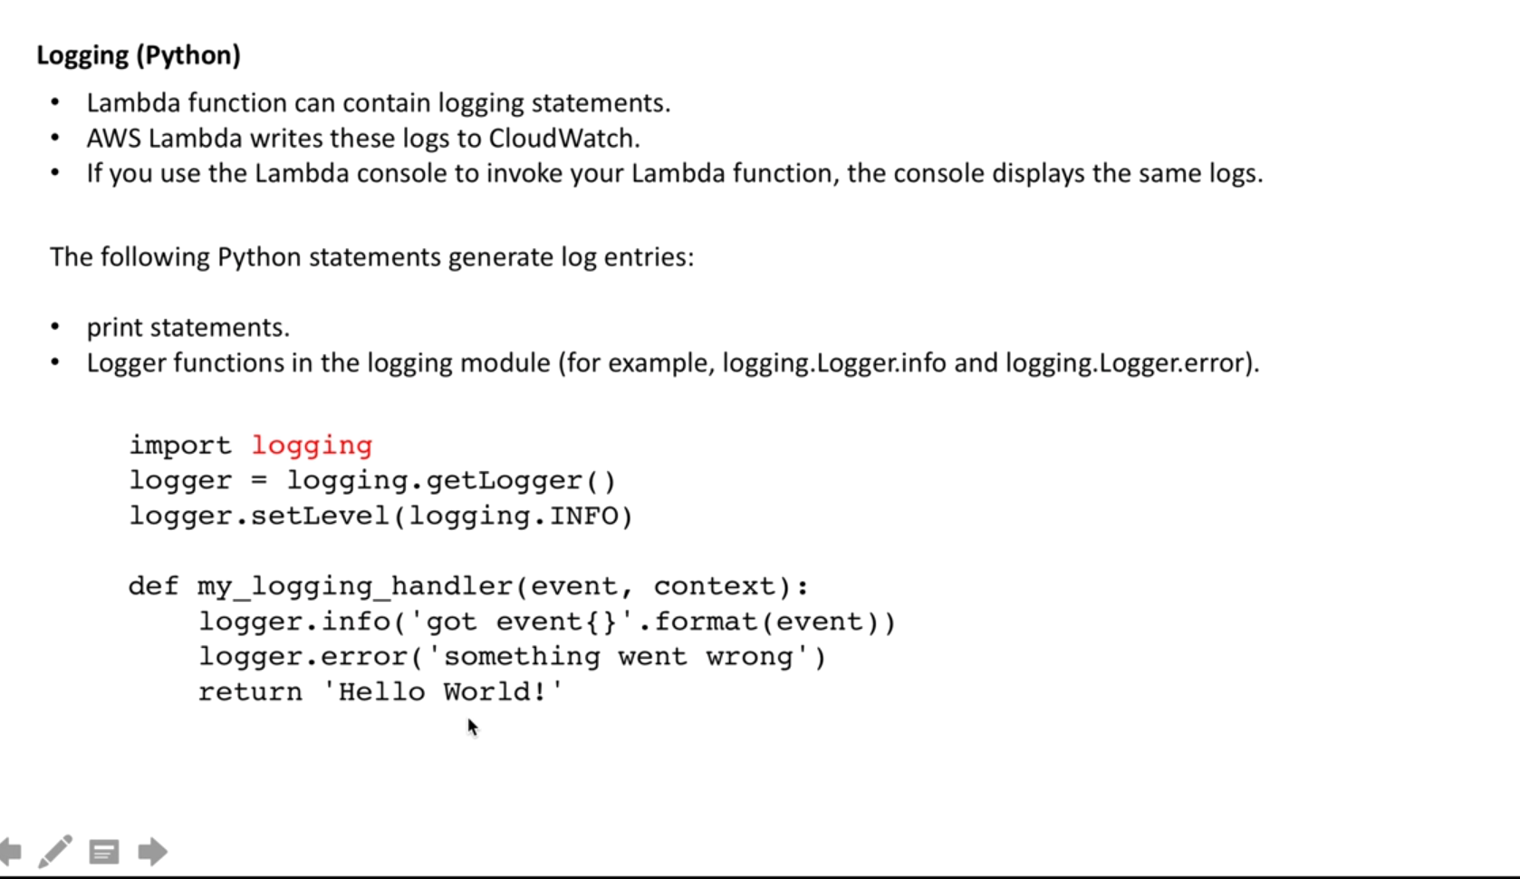

Slide 18
